Slide 1
Knowledge sharing
CKSI
Hypothesis Testing & Regression
June 2019

Slide 2
Introduction to Hypothesis Testing
Data collection has yielded
Average height of Technology services TMs: 5’ 6’’ (sample of 50 TMs)
Average height of Business services TMs: 5’ 4” (sample of 50 TMs)
Questions:
Does this data mean TMs from Business services are shorter than TMs from Technology services?
Or is it simply because the Technology TMs we chose were taller than usual?
Do these two samples come from same population?
To answer these queries, we employ a technique called ‘Hypothesis Testing’

Slide 3
Concept of Hypothesis Testing
1. All processes have variation.
2. Samples from one given process may vary.
3. How can we differentiate between sample–based “chance” variation and a true process difference?

Slide 4
Hypothesis Testing
Refers to the use of statistical analysis to determine if observed differences between two or more data samples are due to random chance or to be true differences in the samples
Increase your confidence that probable X’s are statistically significant
Used when you need to be confident that a statistical difference exists
A hypothesis is an assumption about the population parameter.
A parameter is a characteristic of the population, like its mean or variance.
The parameter must be identified before analysis.

Slide 5
Hypothesis: Null Vs. Alternate
NULL HYPOTHESIS (Hₒ)
States the Assumption (numerical) to be tested e.g. The grade point average of juniors is 3.0 (H ₀ : mu = 3.0 )
Refers to the Status Quo
Usually contains the ‘ = ‘sign
The Null Hypothesis may or may not be rejected
ALTERNATE HYPOTHESIS (H₁)
Is the opposite of the null hypothesis e.g. The grade point average of juniors is less than 3.0 (H ₁ : mu < 3.0 )
Challenges the Status Quo
Never contains the ‘=‘ sign
The Alternative Hypothesis may or may not be accepted

Slide 6
Types of hypotheses
Simple and composite:
A simple hypothesis is a hypothesis which specifies the population distribution
completely.
Eg:H₀: X ~ N(5,20), i.e. µ and σ² are specified
A composite hypothesis is a hypothesis which does not specify the population
distribution completely.
Eg:H₀: X ~ N(5, σ²), i.e. σ² is not specified
Both Null hypothesis and Alternative hypothesis can be simple as well as composite.
http://math.arizona.edu/~jwatkins/r-composite.pdf

Slide 7
Hypothesis Testing Process
Assume the
population
mean age is 50.
(Null Hypothesis)
Population
Is
X
=
20
≅
μ
=
50?
The Sample
Mean Is
20
No, not likely!
REJECT
Null Hypothesis
Sample
.

Slide 8
Sampling Distribution
It is unlikely
that we would
...
Therefore, we
get a sample
reject the null
mean of this
hypothesis that
value ...
μ
= 50.
... if in fact this were
the population mean.
20
μ
= 50
Sample Mean
H
0

Slide 9
Justice System Example
The American justice system can be used to illustrate the concept of hypothesis testing.
Assumption is “Innocent until proven guilty”. This corresponds to the null hypothesis.
It requires strong evidence “beyond a reasonable doubt” to convict the defendant. This corresponds to rejecting the null hypothesis and accepting the alternate hypothesis.
H_{o}: person is innocent
H₁: person is guilty

Slide 10
Justice System Example
Four possible outcomes (Guilty Vs. Innocent Example)
Innocent Person is set Free | Correct Decision
An innocent person is jailed | Wrong
Guilty person is set free | Wrong
Guilty person is jailed | Correct Decision
 | Jury Trial
 | Actual Situation
Verdict | Innocent | Guilty
Innocent | Correct | Error (II)
Guilty | Error (I) | Correct

Slide 11
Errors during decision making
Type I Error
Rejecting True Null Hypothesis (“False Positive”)
Probability of Type I error is
Called Level of Significance
Set by researcher; provides critical values for the test
Called Rejection Region of Sampling Distribution
Typical values are 0.01, 0.05, 0.10
Type II Error
Do not reject False Null Hypothesis (“False Negative”)
Probability of Type II error is β
α

Slide 12
Result Possibilities
 | Jury Trial |  |  | Hypothesis Test
 | Actual Situation |  |  | Actual Situation
Verdict | Innocent | Guilty | Decision | H₀ True | H₀ False
Innocent | Correct | Error (II) | Do not reject H₀ | 1- α | Type II error (β)
Guilty | Error (I) | Correct | Reject H₀ | Type I error (α) | Power (1- β)

Slide 13
General Steps in Hypothesis Testing
Test the assumption that the true mean number of of TV sets in U.S. homes is at least three ( Known)
State the H₀
State the H₁
Choose
Choose n
Choose Test

Slide 14
General Steps in Hypothesis Testing
Set up critical value(s)
7. Collect data
8. Compute test statistic and p-value
9. Make statistical decision
10. Express conclusion
100 households surveyed
Computed test statistic =-2, p-value = .0228
Reject null hypothesis
The true mean number of TV sets is less than 3
Reject H₀
α
Z
-1.645

Slide 15
Level of Significance and the Rejection Region
α
H₀: μ ≥ 3 H₁: μ < 3
Critical Value(s)
Rejection Regions
0
α
H₀: μ ≤ 3 H₁: μ > 3
0
α/2
H₀: μ = 3 H₁: μ ≠ 3
0

Slide 16
Rejection Region
H₀: μ ≥ μ₀ H₁: μ < μ₀
H₀: μ ≤ μ₀ H₁: μ > μ₀
Reject H₀
Reject H₀
0
Z
0
Z
Small values of Z don’t contradict H₀ Don’t Reject H₀ !
Z Must Be Significantly Below 0 to reject H₀

Slide 17
Example: One Tail Test
Q. Does an average box of Archer Farms cookies contain more than 368 grams of cereal? A random sample of 25 boxes showed = 372.5. The company has specified σ to be 15 grams. Test at the α = 0.05 level.
H₀: μ ≤ 368 H₁: μ > 368

Slide 18
First Solution: One Tail z-Test
H₀: μ ≤ 368
H₁: μ > 368
Test Statistic:
Decision:
Conclusion:
α = 0.5
n = 25
Critical Value: 1.645
Do Not Reject at α = .05
Reject
.05
No evidence that true mean is more than 368
0
1.645
Z
1.50

Slide 19
Second Solution: p-Value
The probability of getting the observed difference or greater when H_{o} is true.
A p-value is a measure of how much evidence we have against the null hypothesis.
Is the lowest significance level such that we will still reject H_{o}. For a two tailed test, we use twice the table value to find p, and for a one tailed test, we use the table value
Ranges from 0.0 - 1.0
If p ≥ 0.05, then there is no statistical evidence of a difference existing.
Called observed level of significance
P < α: Reject H_{o}
P > α : Accept H_{o}

Slide 20
Second solution: p-Value Approach to Testing
The p-value measures consistency by calculating the probability of observing the results from your sample of data or a sample with results more extreme, assuming the null hypothesis is true. The smaller the p-value, the greater the inconsistency.
Consider an experiment where you've measured values in two samples, and the means are different. How sure are you that the population means are different as well? There are two possibilities:
The populations have different means.
The populations have the same mean, and the difference you observed is a coincidence of random sampling.
The P value is the answer to this question: If the populations really have the same mean overall, what is the probability that random sampling would lead to a difference between sample means as large (or larger) than you observed?

Slide 21
p -Value Solution
(p-Value = 0.0668) ≥ (α = 0.05) ? Yes So, Do Not Reject.
p Value = 0.0668
Reject
α = 0.05
0
Z
1.645
1.50
Test Statistic 1.50 is in the ‘Do Not Reject’ Region

Slide 22
Third Solution: Connection to Confidence Intervals

Slide 23
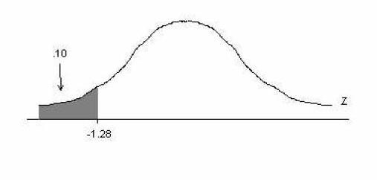
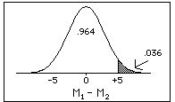

One tail vs. two tailed
Description | Region | When to use? | Remarks
One tailed |  | H₁: μ > μ₀ OR H₁: μ < μ₀ | Use when objective is to find if the hypothesized mean is higher (or lower); Unidirectional
Two tailed |  | μ_{prev} ≠ μ_{current} | Assess when not concerned with direction; E.g. Comparing two means
Table you have | Operation | To get ...
One-tailed | Divide P by 2 | Two-tailed test for P/2
Two-tailed | Multiply P by 2 | One-tailed test for 2P
Impact on p-value
Notes:
For example, assume you have a table to a one-tail test at the 98% confidence level and want to perform a two-tailed test. For the 98% confidence level, P = 0.02. Divide P by 2 to get 0.01, which is a 99% confidence level. So you would compare tcalc to the value from the 98% one-tailed table, and it would be equivalent to a two-tailed test at the 99% confidence level.

Slide 24
Hypothesis Testing: Hiring Policy
A recruiter must decide who to hire. This is like forming a hypothesis about whether or not the individual is predicted to be a good employee. Assume that an employee is either good or poor.
What are the null and alternate hypothesis?
NULL: The individual does not meet the standards (MEAN<=Z)
ALTERNATIVE: The individual meets the standards (MEAN>Z)
What are the possible errors that a recruiter can make? How do these relate to Type I and Type II errors?
Failure to hire a good employee; failure to reject a false null= type II error
Failure to reject a poor employee; rejecting a null when it is really true = type I error

Slide 25
Hiring Policy Example continued
A positive decision is a decision to reject the null. A false positive is therefore a type I error (hiring a poor person).
A negative decision is a failure to reject the null. A false negative is therefore a type II error (not hiring a good person) .
The addition of more criteria should increase your ability to distinguish poor candidates => type I error falls.
However, more criteria mean that more good employees are cut accidentally => type II error increases. When do you use more criteria?

Slide 26
Dimensions of Hypothesis Testing
Hypothesis Testing technique offers many dimensions
Tests for means (Small and Large Samples)
Tests for equality of variances
Tests for independence/homogeneity between nominal variables

Slide 27
Tests for Means
There are different tests that can be used to test the hypotheses about means
One-sample Z test
One-sample t test
t-test for dependent means
t-test for independent means

Slide 28
Z Tests
Perform z test when:
Random sample follows a Normal distribution
Mean is known
Population standard deviation is known
Large sample (n>30)
Z test can be used
For testing mean of single sample
For testing means of two independent samples

Slide 29
Example
Maxwell’s Hot Chocolate is concerned about the effect of the recent years long coffee advertising campaign on hot chocolate sales. The average hot chocolate sales two years ago was 984.7 pounds and the standard deviation was 99.6 pounds.
Maxwell randomly selected 30 weeks from the past year and found average sales to be 967.1 pounds.
Test: a. Whether the hot chocolate sales have decreased?
b. At 5% level of significance help the Maxwell hot chocolate to take a decision?
Ho: μ = 984.7 vs. H1: μ < 984.7
Under Ho, the test statistics is:
Ζ = -0.96 p value = 0.429
What do we conclude?
We do not enough evidence reject the null hypothesis.
Note: In Excel Use NORMSDIST function to compute the p value.

Slide 30
T Test
Perform t test when:
Random sample follows a Normal distribution
Mean is known
Population Variance is unknown
Small sample (n< =30)
T test can be used
For testing mean of single sample
For testing means of two independent samples
Difference between means of dependent sample

Slide 31
Example
You seek to determine whether differences exist in monthly sales between the new package design and the old package design of a laundry stain remover. The new package was test marketed over a period of one month in a sample of supermarkets in a particular city.
A random sample of ten pairs of supermarkets was matched according to weekly sales volume and a set of demographic characteristics. The data collected for this study are as follows:
What is that we want to answer?
Super-markets | New Package | Old Package | diff
1 | 458 | 437 | 21
2 | 519 | 488 | 31
3 | 394 | 409 | -15
4 | 632 | 587 | 45
5 | 768 | 753 | 15
6 | 348 | 400 | -52
7 | 572 | 508 | 64
8 | 704 | 695 | 9
9 | 527 | 496 | 31
10 | 584 | 513 | 71

Slide 32
Data and Results
Ho: μ_{d} = 0 vs. Ha: μ _{d} ne 0
Under Ho, the test statistic
T_{d} =1.9116
Df = 9
P value = 0.0882
What should we infer?
Do not reject the null hypothesis
No differences exist in monthly sales between the new package design and the old package design of a laundry stain remover.
Note: In Excel, use the TTEST function to compute the p value.

Slide 33
F Test
Perform F test when:
Populations from which the random samples are drawn are normal and independent
Let s₁²and s₂² be the sample variances
F test can be used
to test the hypothesis of equality of two population variances
to test for equality of several means is carried out by the technique named ANOVA
to test the significance of the regression model

Slide 34

Example1
Two chemical companies supply a raw material. The concentration of a particular element in this material is
important. The mean concentration for both suppliers is the same, but we suspect that the variability in concentration may differ between the two companies.
The standard deviation of
concentration in a random sample of n1=10 batches produced
by company 1 is s1 = 4.7 grams per liter, while for company 2, a random sample of n2 = 16 batches yields s2= 5.8 grams per liter.
Is there sufficient evidence to conclude that the two population variances differ?
Ho : σ1² = σ2² vs.
Ha : σ1² σ2²
Under Ho, the test statistics
F = 0.6577
df = 9, 15
p value = 0.733
What should we infer?
Since p value >0.05, we do no have enough evidence to reject the hypothesis.

Slide 35
Example 2
A fuel-economy study was conducted for two German automobiles, Mercedes and Volkswagen. One vehicle of each brand was selected, and the mileage performance was observed for 10 tanks of fuel in each car.
Is there evidence to support the claim that the variability in mileage performance is lesser for a Mercedes than for a Volkswagen?
Data
Mercedes | Volkswagen
24.7 | 41.7
24.8 | 42.3
24.9 | 41.6
24.7 | 39.5
24.5 | 41.9
24.9 | 42.8
24.6 | 42.4
24.6 | 39.9
24.9 | 40.8
24.8 | 39.6
How should we frame the hypothesis?
Ho : σ1² < = σ2² vs.
Ha : σ1² > σ2²
Under the null hypothesis, the test statistics is:
F =0.0137 with df = 9,9
p value = 2.50E-07
What do we infer?

Slide 36
Chi Square Tests
Categorical data lead to counts within each category
Tests the association/ independence between nominal(categorical) variables
Null Hypothesis: The 2 variables are independent
Tests the homogeneity between categorical variables
Measure of goodness-of -fit
Its really just a comparison between expected frequencies and observed frequencies among the cells in a cross tabulation table

Slide 37
Requirements for Chi-Square test
Must be a random sample from population
Data must be in raw frequencies
Variables must be independent
Categories for each cell must be mutually exclusive and exhaustive
Using the Chi-Square Test
Often used with contingency tables (i.e., cross tabulations)
•E.g., gender x race
Basically, the chi-square test of independence tests whether the columns are contingent on the rows in the table.
•In this case, the null hypothesis is that there is no relationship between row and column frequencies.

Slide 38
Example
Fast-food chains are evaluated on many variables and the results are summarized periodically in QSR Magazine. One important variable is the accuracy of the order.
You seek to determine, with a
level of significance of α = 0.05, whether a difference exists in the proportions
of food orders filled correctly at Burger King, Wendy’s, and McDonald’s.
How will you frame the hypothesis?
Ho: No difference exists in the proportion of correct orders among Burger King, Wendy’s, and McDonald’s.
H1: A difference exists in the proportion of correct orders among Burger King, Wendy’s, and McDonald’s
Under Ho the test statistics is as follows:

Slide 39
The following data report the results of placing an order consisting of a main item, a side item, and a drink
 | Fast Food Chain
 |  | Burger King | Wendy’s | McDonald’s | Total
Order Filled Correctly | Yes | 440 | 430 | 422 | 1292
 | No | 60 | 70 | 78 | 208
 | Total | 500 | 500 | 500 | 1500
Under Ho, test statistic
χ² = 2.72
p value = 0.256
d.f. = 2
 | Expected Frequencies
 |  | Burger King | Wendy’s | McDonald’s
Order Filled Correctly | Yes | 431 | 431 | 431
 | No | 69 | 69 | 69
 | Total | 500 | 500 | 500
What do we infer?
We do not have enough evidence to reject the null hypothesis.

Slide 40
Example
You want to determine (at the 0.05 level of significance) whether the media that people turn to for news is different for
various age groups. A study indicated where different age groups primarily
get their news:
Ho: No relationship exists between the age group and the media where people get their news.
H1: A relationship exists between the age group and the media where people get their news.
χ² = 22.18
DF =8
P value = 0.0045
 | Age Group
 |  | Under 36 | 36–50 | 50+
Media | Local TV | 107 | 119 | 133
 | National TV | 73 | 102 | 127
 | Radio | 75 | 97 | 109
 | Local newspaper | 52 | 79 | 107
 | Internet | 95 | 83 | 76
What do we infer?

Slide 41
Summary of Parametric Tests

Slide 42
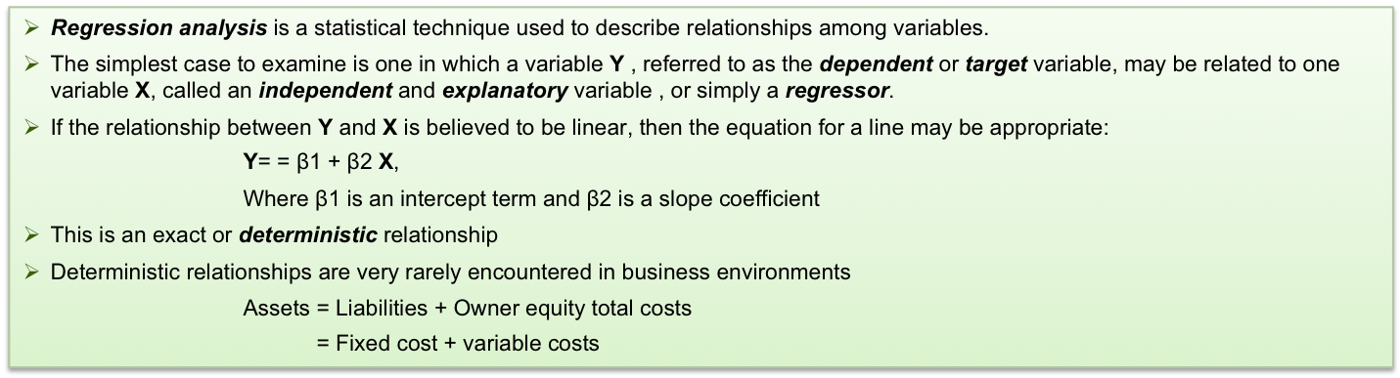
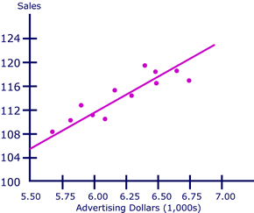
Regression Analysis…
Y and X largely obey an approximately linear relationship
How to fit a line to describe the ”broadly linear” relationship between Y and X when the (x, y) pairs do not all lie on a straight line?
Consider the pairs (xi,yi)
Let ˆyi be the predicted value of yi
ei = yi- ˆyi as the residual representing the error involved
Several approaches are there to minimize the error :
1. Minimize the sum of the errors
2. Minimize the sum of the absolute error
3. Least square method

Slide 43
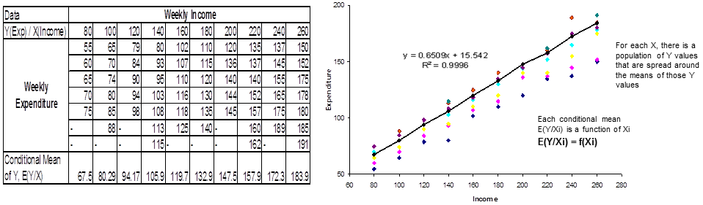
Regression Analysis…
Lets take a data of 60 families with their weekly income & weekly consumption expenditure.
The 60 families are divided into 10 income groups and the weekly consumption expenditure of each family in each income group is shown below:
There is considerable variation in the weekly consumption expenditure in each income group. The general picture is that, despite the variability, on an average the weekly consumption expenditure increases as income increases.
In the above case, we see that E(Y/Xi) is a linear function of Xi (i.e. expenditure is linearly related to income)
E(Y/Xi) = β1 + β2Xi (where β1 & β2 are also known as intercept and the slope coefficients respectively)

Slide 44
Difference between correlation and regression
Basic for comparison | Correlation | Regression
Meaning | Correlation is a statistical measure which determines co-relationship or association of two variables | Regression describes how an independent variable is numerically related to the dependent variable
Usage | Represent linear relationship between two variables | Fit a best line and estimate one variable on the basis of another variable
Indicates | Correlation coefficient indicates the extent to which two variables move together | Regression indicates the impact of a unit change in the known variable (x) on the estimated variable (y)
Objective | To find a numerical value expressing the relationship between variables | Estimate values of random variable on the basis of the values of fixed variable

Slide 45
Thank you

